Slide 1

CS244
Advanced Topics in Networking
Lecture 7: Programmable Forwarding
Nick McKeown
“Forwarding Metamorphosis: Fast Programmable Match-Action Processing in Hardware for SDN”
[Pat Bosshart et al. 2013]
Spring 2020

Slide 2
Context
Pat Bosshart
At the time: TI (Texas Instruments)
Architect of first LISP CPU and 1GHz DSP
+ Others from TI
George Varghese
At the time: MSR
Today: Professor at UCLA
+ Others from Stanford
At the time the paper was written (2012)…
Fastest switch ASICs were fixed function, around 1Tb/s
Lots of interest in “disaggregated” switches for large data-centers

Slide 3
Switch with fixed function pipeline
L2 Table
IPv4 Table
IPv6 Table
ACL Table
L2 Hdr Actions
IP Hdr Actions
v6 Hdr Actions
ACL Actions
Fixed Parser
Fixed Header Processing Pipeline

Slide 4
You said
Amalee Wilson
There’s a key phrase in the abstract, “contrary to concerns within the community,” and I’m curious about what those concerns are.

Slide 5
“Programmable switches run 10x slower, consume more power and cost more.”
Conventional wisdom in 2010

Slide 6
Packet Forwarding Speeds
6.4Tb/s
Gb/s
(per chip)
Notes:
Here is a graph of the packet forwarding speed of switch chips since 1990 <graph of switch chip>. In 2016, the fastest switches run at 6.4Tb/s

Slide 7
Packet Forwarding Speeds
6.4Tb/s
80x
Gb/s
(per chip)
Notes:
If we compare it with the fastest reported hero experiments switching packets on a CPU, the difference is about 80x. <click>
And the difference is still growing. Clearly we can’t use CPUs to build fast switches.

Slide 8
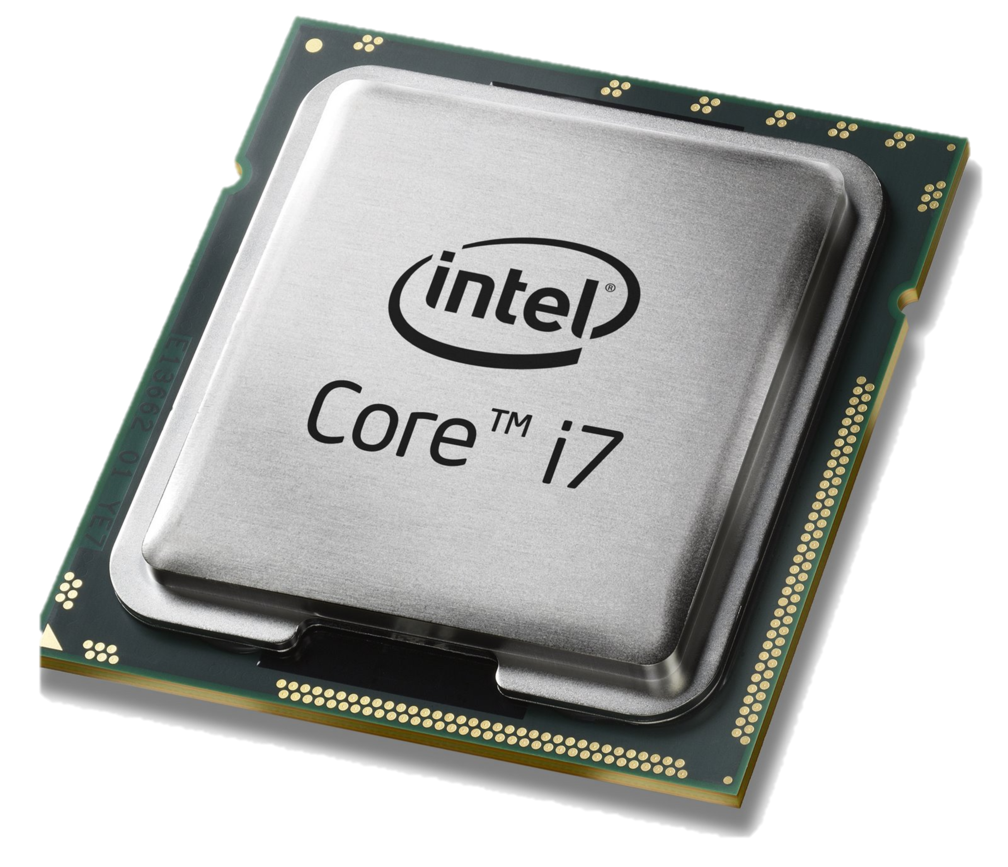
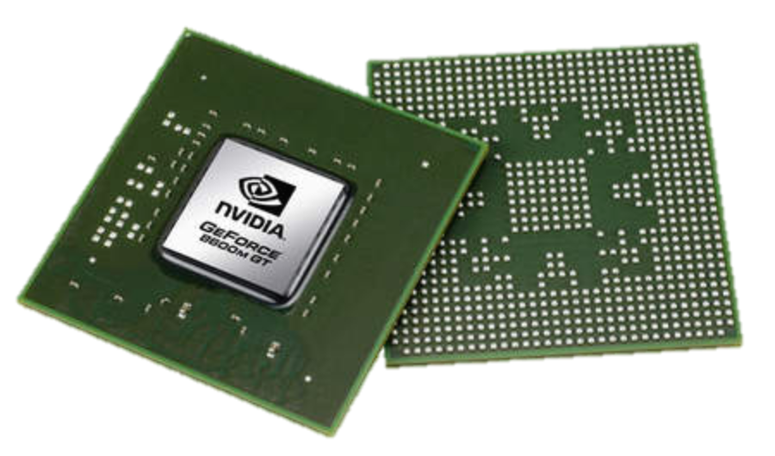
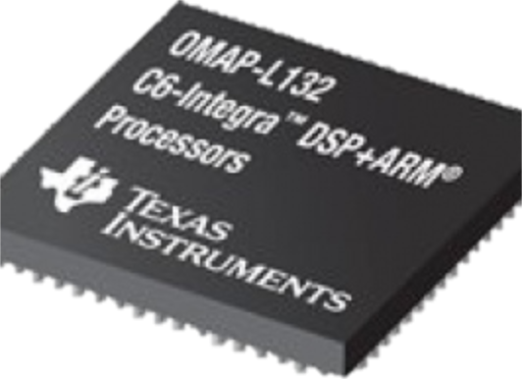
Domain Specific Processors
Signal
Processing
Machine
Learning
Computers
Graphics
Networking
Java
OpenCL
Matlab
TensorFlow
>>
Language
Compiler
Compiler
Compiler
Compiler
Compiler
?
?
CPU
GPU
DSP
TPU

Slide 9
Domain Specific Processors
Signal
Processing
Machine
Learning
Computers
Graphics
Networking
Java
OpenCL
Matlab
TensorFlow
>>
P4
Compiler
Compiler
Compiler
Compiler
Compiler
?
CPU
GPU
DSP
TPU
PISA
aka “RMT”

Slide 10

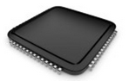
Network systems tend to be designed “bottom-up”
Switch OS
Driver
“This is how I process packets …”
Fixed-function switch

Slide 11
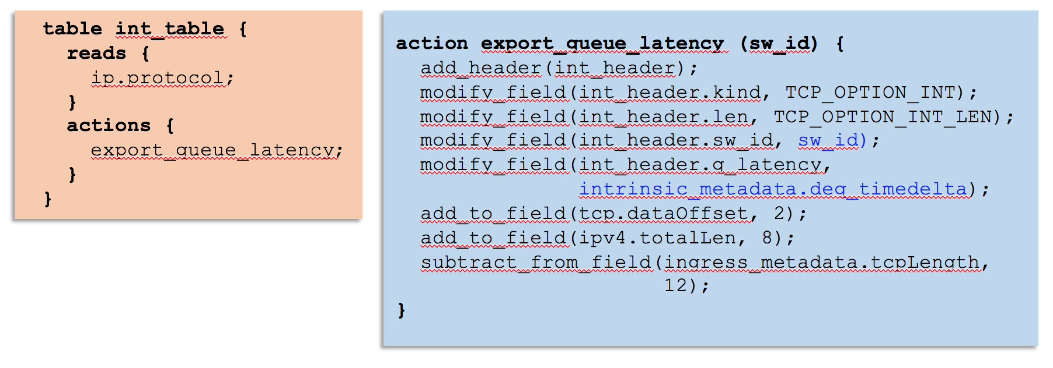
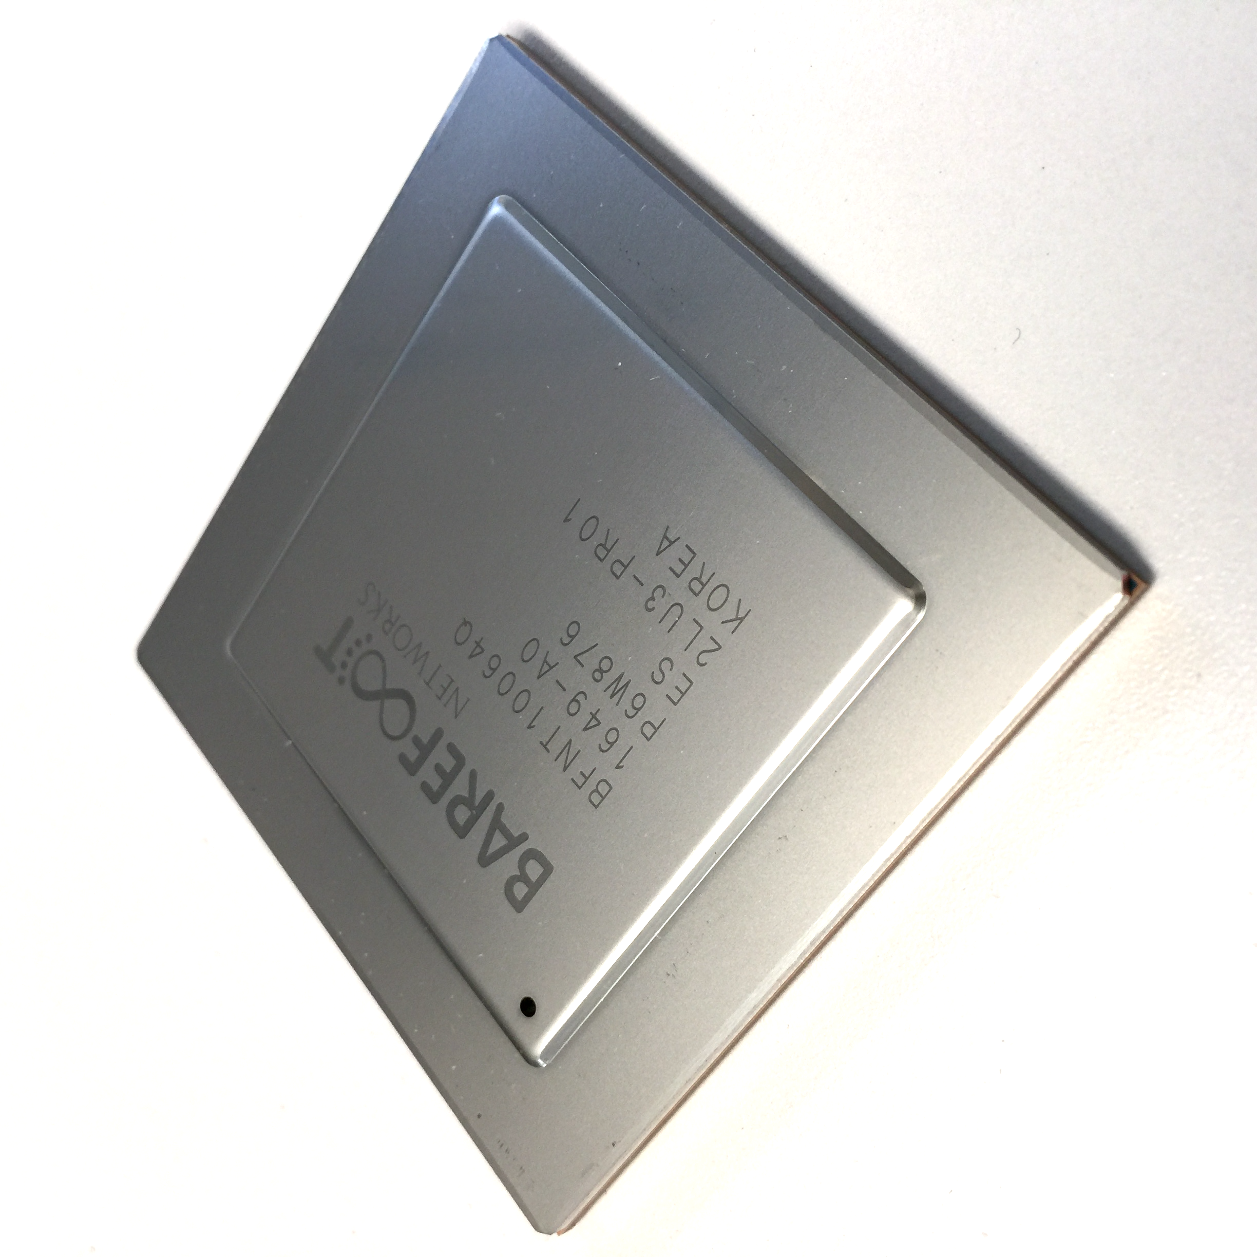
What if they could be programmed “top-down”?
“This is precisely how you must process packets”
Switch OS
Driver
Programmable Switch

Slide 12
You said
Wantong Jiang:
At the end of the paper, the authors mention FPGA and claim that they are too expensive. This paper was published in 2013 and I wonder if it's still the case nowadays.
Firas Abuzaid:
The paper mentions that FPGAs are too expensive to be considered. Now that FPGAs have become more widely available, could they be used instead of RMTs?

Slide 13
The RMT design [2013]

Slide 14
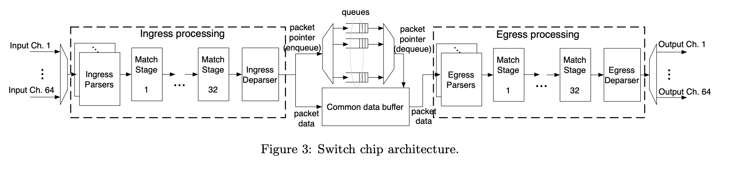
Programmable
parsers
Packet Buffers
Programmable
De-parsers
Match+Action
Pipeline
Match+Action
Pipeline
Notes:
Go along pipeline explaining each in turn, with questions:
Q: What is the programmable parser for and why is it programmable? How is it constructed? (State machine)
Q: The match + action pipeline: What happens in each stage? Why is this a reasonable abstraction? What determines the number of stages?
Q: Packet buffers: What is the buffer architecture: IQ, IQ + VOQ, OQ or …? (shared buffer = OQ where one large pool of buffers supports Oqs for all outputs. What is the memory b/w requirement?)
Q: Egress pipeline: Why have one? (multicast and things you do after the packet buffer).
Q: Egress deparser: Having acted upon the packet, put It all back together again into a legal packet before sending.
Q: What other data paths might there be inside? Connection to CPU. Connection for loopback to re-enter pipeline.

Slide 15
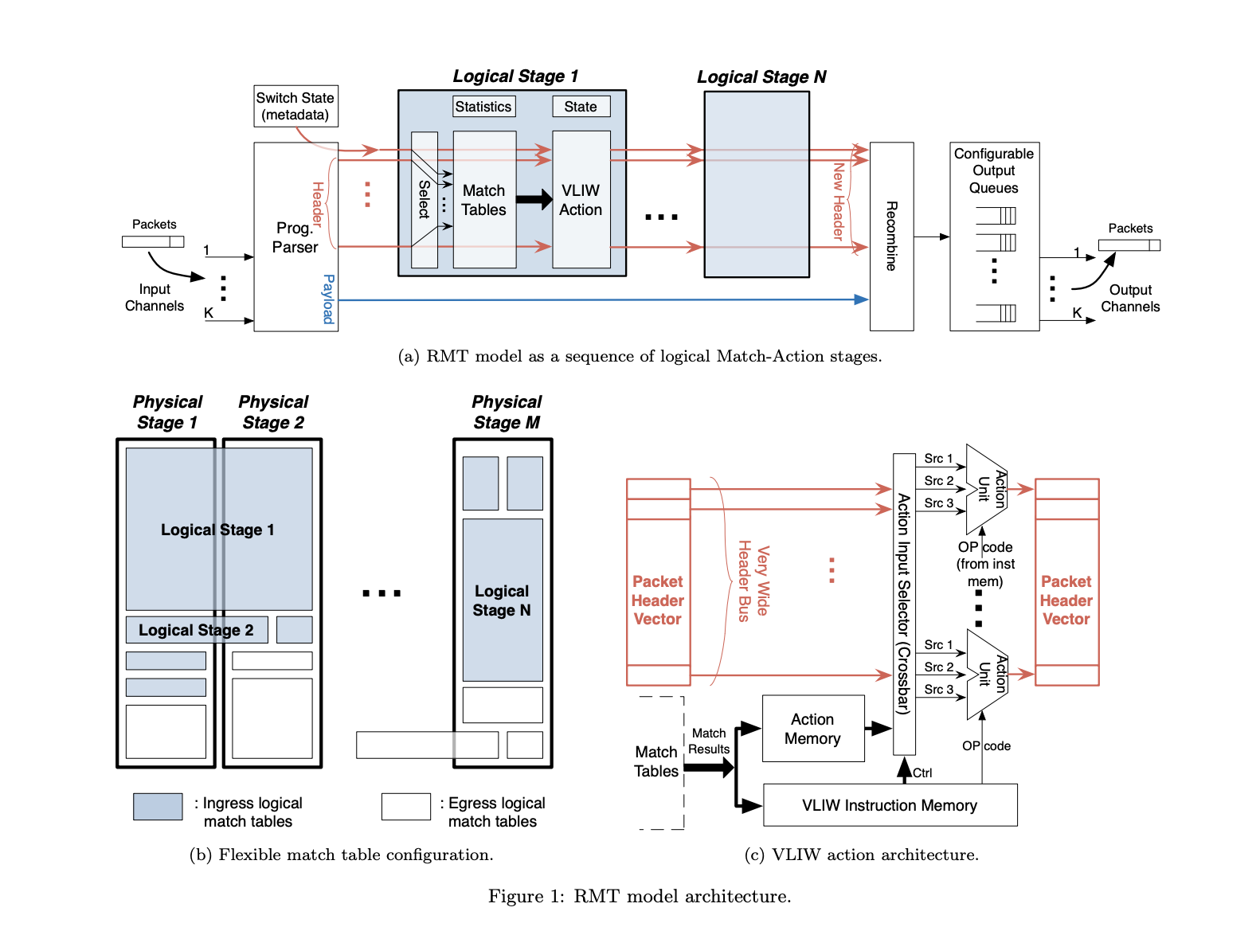
Notes:
1(b) In principle, memory tables can extend across multiple stages.
1©. Very wide header bus, called the header vector or PHV. This shows how the ALUs operate on the PHV. In practice, the PHV has multiple fixed size fields.

Slide 16
You said
Will Brand
[W]hat goes into designing the vocabulary of a RISC instruction set? Since I can't just try to prove the instructions are Turing-complete, and the instruction set doesn't have the kind of specification I might expect from a general-purpose language, I find it difficult to "trust" that Table 1 encapsulates a reasonable portion of the actions we might want to make possible…

Slide 17
PISA: Protocol Independent Switch Architecture
Programmer declares which
headers are recognized
Programmer declares what
tables are needed and how packets are processed
Match+Action
Memory
ALU
Programmable
Parser
All stages are identical. A “compiler target”.
Notes:
PISA chips are also built around a pipeline. But in PISA, all the pipeline stages are all IDENTICAL. They initially don’t know anything about protocols – they are sitting waiting to receive instructions from the compiler.
The basic operations of each stage is called “Match + Action” – In each stage, there is a set of memories which match on headers,
Depending on the match, an action is applied to the header by an ALU. And then the header is passed to the next stage, and so on.
A PISA chip is initially blank – it doesn’t know about any protocols.
The P4 programmer tells the programmable parser what packet headers it should recognize.
If a new header is developed, we add it to the set of headers the parser recognizes.
Let’s take a closer look at how a packet is processed …..

Slide 18
PISA: Protocol Independent Switch Architecture
Programmable
Parser

Slide 19
PISA: Protocol Independent Switch Architecture
Ethernet
MAC
Address
Table
MPLS
Tag
Table
IPv4
Address Table
Programmable
Parser
ACL
Rules

Slide 20
PISA: Protocol Independent Switch Architecture
Ethernet
MAC
Address
Table
MPLS
Tag
Table
IPv4
Address Table
Programmable
Parser
ACL
Rules
IPv6
Address Table
VXLAN

Slide 21
P4 program example: Parsing Headers
IPv4
ACL
Ethernet
My Encap
MyEncap
IPv6
header_type ethernet_t {
fields {
dstAddr : 48;
srcAddr : 48;
etherType : 16;
}
}
Ethernet
My Encap
parser parse_ethernet {
extract(ethernet);
return select(latest.etherType) {
0x8100 : parse_my_encap;
0x800 : parse_ipv4;
0x86DD : parse_ipv6;
}
}
IPv4
IPv6
header_type my_encap_t {
fields {
foo : 12;
bar : 8;
baz : 4;
qux : 4;
next_protocol : 4;
}
}
TCP

Slide 22
P4 program example
IPv4
ACL
Ethernet
My Encap
MyEncap
IPv6
table ipv4_lpm
{
reads {
ipv4.dstAddr : lpm;
}
actions {
set_next_hop;
drop;
}
}
control ingress
{
apply(l2);
apply(my_encap);
if (valid(ipv4) {
apply(ipv4_lpm);
} else {
apply(ipv6_lpm);
}
apply(acl);
}
action set_next_hop(nhop_ipv4_addr, port)
{
modify_field(metadata.nhop_ipv4_addr, nhop_ipv4_addr);
modify_field(standard_metadata.egress_port, port);
add_to_field(ipv4.ttl, -1);
}

Slide 23
How programmability is used
Reducing complexity
1

Slide 24
Reducing complexity
switch.p4
Switch OS
Driver
IPv4 and IPv6 routing
- Unicast Routing
- Routed Ports & SVI
- VRF
- Unicast RPF - Strict and Loose
- Multicast
- PIM-SM/DM & PIM-Bidir
Ethernet switching
- VLAN Flooding
- MAC Learning & Aging
- STP state
- VLAN Translation
Load balancing
- LAG
- ECMP & WCMP
- Resilient Hashing
- Flowlet Switching
Fast Failover
– LAG & ECMP
Tunneling
- IPv4 and IPv6 Routing & Switching
- IP-in-IP (6in4, 4in4)
- VXLAN, NVGRE, GENEVE & GRE
- Segment Routing, ILA
MPLS
- LER and LSR
- IPv4/v6 routing (L3VPN)
- L2 switching (EoMPLS, VPLS)
- MPLS over UDP/GRE
ACL
- MAC ACL, IPv4/v6 ACL, RACL
- QoS ACL, System ACL, PBR
- Port Range lookups in ACLs
QOS
- QoS Classification & marking
- Drop profiles/WRED
- RoCE v2 & FCoE
- CoPP (Control plane policing)
NAT and L4 Load Balancing
Security Features
- Storm Control, IP Source Guard
Monitoring & Telemetry
Ingress Mirroring and Egress Mirroring
Negative Mirroring
Sflow
INT
Counters
Route Table Entry Counters
VLAN/Bridge Domain Counters
Port/Interface Counters
Protocol Offload
- BFD, OAM
Multi-chip Fabric Support
- Forwarding, QOS
Compiler
Programmable Switch

Slide 25
Reducing complexity
My switch.p4
Switch OS
Driver
Compiler
Programmable Switch

Slide 26
How programmability is used
Adding new features
2

Slide 27
Protocol complexity 20 years ago
Ethernet
ethtype
ethtype
IPv4
IPX
Notes:
Back in the 1990s, a switch chip only needed to support 2 or 3 protocols.

Slide 28
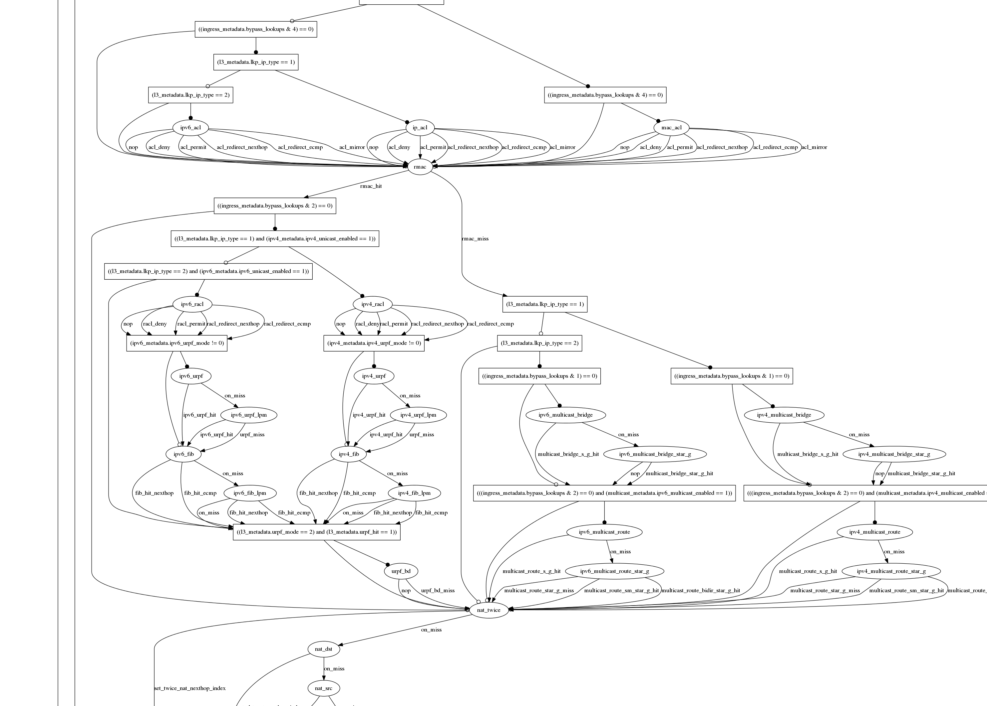
Datacenter switch today
switch.p4
Notes:
Today, it needs to support dozens. This is the typical set of protocols supported in a data center top of rack switch today. It is getting almost impossible to design fixed function chips with all the protocols, and to get it right.
If the chip is programmable, the chip design is much simpler. Complicated protocols are just programs written later by the user.
You can see how switch chips get more uniform as they become more programmable.

Slide 29
Example new features
New encapsulations and tunnels
New ways to tag packets for special treatment
New approaches to routing: e.g. source routing in DCs
New approaches to congestion control
New ways to process packets: e.g. ticker-symbols

Slide 30
Example new features
Layer-4 Load Balancer¹
Replace 100 servers or 10 dedicated boxes with one programmable switch
Track and maintain mapping for 5-10 million http flows
Fast stateless firewall
Add/delete and track 100s of thousands of new connections per second
Cache for Key-value store²
Memcache in-network cache for 100 servers
1-2 billion operations per second
[1] “SilkRoad: Making Stateful Layer-4 Load Balancing Fast and Cheap Using Switching ASICs.” Rui Miao et al. Sigcomm 2017.
[2] “NetCache: Balancing Key-Value Stores with Fast In-Network Caching”, Xin Jin et al. SOSP 2017

Slide 31
How programmability is used
Network telemetry
3

Slide 32
“I visited Switch 1 @780ns, Switch 9 @1.3µs, Switch 12 @2.4µs”
1
“Which path did my packet take?”
# | Rule
1
2
3
…
75 | 192.168.0/24
…
“In Switch 1, I followed rules 75 and 250. In Switch 9, I followed rules 3 and 80. ”
2
“Which rules did my packet follow?”
Notes:
But if we want to have complete visibility into exactly what our network is doing, all the time, then we need to answer four questions.
First: Which path did my packet take? I want every packet to tell me which switches it visited and when, to the nanosecond.
Second: When it passed through the switches, which rules did it match on? I want every packet to tell me which rules it matched on along the way, so I can tell exactly why it reached this point.

Slide 33
3
“How long did my packet queue at each switch?”
“Delay: 100ns, 200ns, 19740ns”
Queue
4
“Who did my packet share the queue with?”
Time
Notes:
Third: How long did my packet spend in the queue at each switch along the way? I want every packet to tell me how long it was sitting in a queue, to the nanosecond.
In this case, we can see that the queue spent a long time in the 3rd switch, which must be because of congestion. I need to know who caused the congestion, so I want to have the switch tell me. This leads to my final question:
“Who did my packet share the queue with?”

Slide 34
3
“How long did my packet queue at each switch?”
“Delay: 100ns, 200ns, 19740ns”
Aggressor flow!
Queue
4
“Who did my packet share the queue with?”
Time
Notes:
Once I know who I shared the queue with, and I can see that all these orange packets are causing congestion, I can identify the flow, the application, the server and the real culprit.

Slide 35
These seem like pretty important questions
1
“Which path did my packet take?”
“Which rules did my packet follow?”
“How long did it queue at each switch?”
“Who did it share the queues with?”
2
3
4
A programmable device can potentially answer all four questions.
At line rate.
Notes:
Let’s summarize the four questions. These are the holy grail of network monitoring: They represent the complete ground truth of what’s happening in the network.
This information has never been available before in a network in the history of networking, because most people consider it too hard to capture.

Slide 36
INT: In-band Network Telemetry
Add: SwitchID, Arrival Time, Queue Delay, Matched Rules, …
Original Packet
Log, Analyze
Replay
Visualize

Slide 37
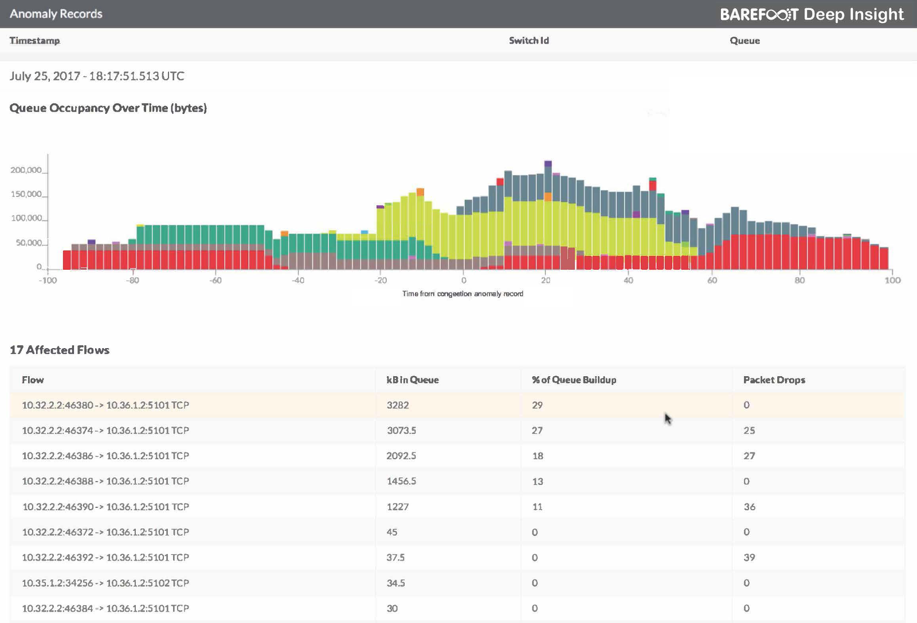
Example using INT
[nanoseconds]

Slide 38
End.

